Slide 1
Mathematical Foundations for Data Science
MFDS Team

Slide 2
DSECL ZC416, MFDS
Lecture No. 9

Slide 3
Agenda
Functions
Limits
Continuity
Intermediate Value Theorem
Differentiability
Taylor series expansion
Maxima and minima

Slide 4
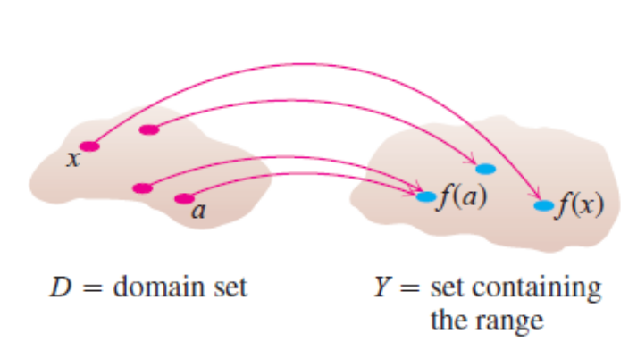
Functions
Definition: Let A and B be nonempty sets. A function f from A to B, denoted
f: A → B is an assignment of each element of A to exactly one element of B. We
write f(a) = b if b is the unique element of B assigned by the function f to the
element a of A.
Functions are sometimes called mappings or transformations.
Students
Grades
A
Student 1
B
Student 2
C
Student 3
D
Student 4
F

Slide 5
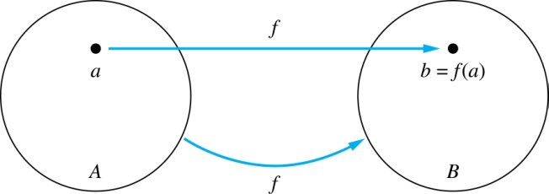
Functions
Given a function f: A → B:
We say f maps A to B or f is a mapping from A to B.
A is called the domain of f.
B is called the co-domain of f.
If f(a) = b,
  then b is called the image of a under f.
  a is called the preimage of b.
The range of f is the set of all images of points in A under f. We denote it by f(A).
Two functions are equal when they have the same domain, the same co-domain
and map each element of the domain to the same element of the co-domain.

Slide 6
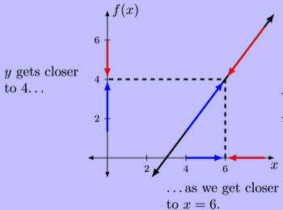
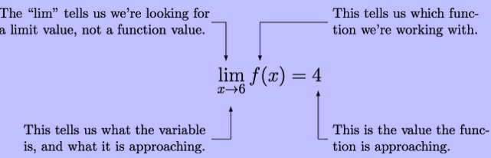
Concept of Limits
Limit of the function – Value that f(x) gets closer to as x
approaches some number

Slide 7



One sided Limits
Right Handed Limit
Can make f(x) as close to L as we want for all x sufficiently close to a with x > a without actually letting x be a
Left Handed Limit
Can make f(x) as close to L as we want for all x sufficiently close to a with x < a without actually letting x be a
NOTE: If two one sided limits have different value, then normal limit will not exist

Slide 8
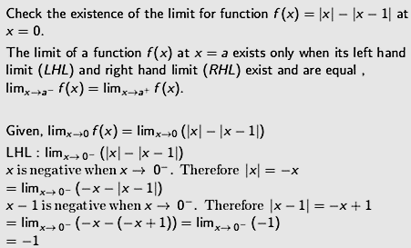
Limits

Slide 9
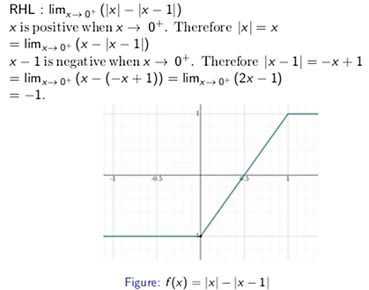
Limits

Slide 10
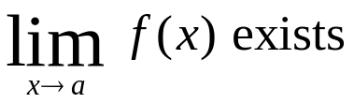
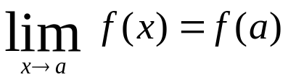
Continuity
Let f be a function. The f is continuous at x = a if
f(a) is defined This means a is in the domain of f.
This means there exists a finite limit at x = a.
This means at x = a the limit is equal to the functional value.
If a function is not continuous at a we say f is discontinuous at a.
A function is continuous on its domain if it is continuous at each point in the domain of f.

Slide 11
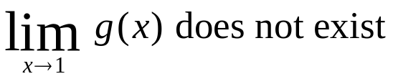
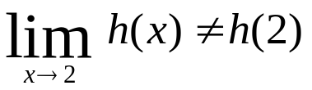
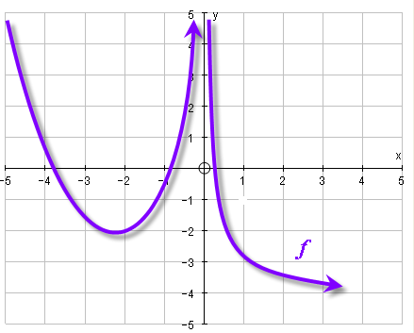
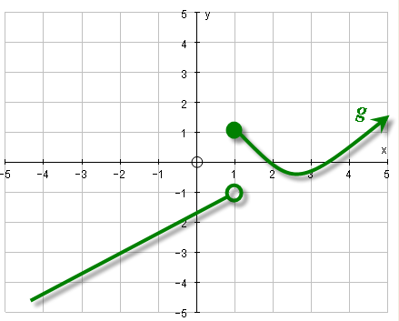
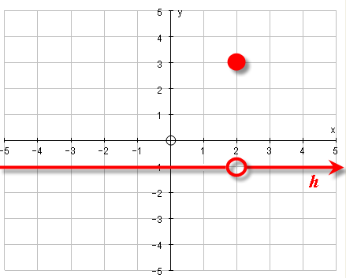
Continuity
f(0) is not defined.
The function is continuous on its domain, but not continuous at every real number.
The function does not have a limit at x = a.
The limit and the functional value are not equal x = a.

Slide 12
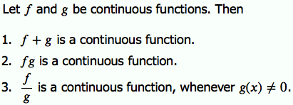
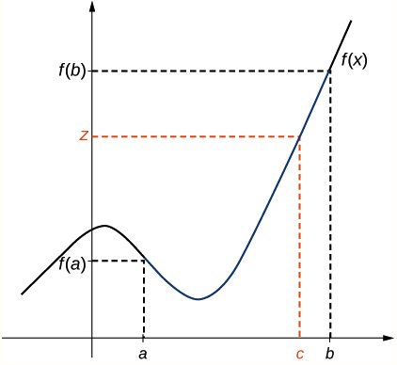
Properties of Continuous Function
INTERMEDIATE VALUE THEOREM
Note: If a function is continuous over a closed interval, then function takes on every value between the values at its end points

Slide 13
Intermediate Value Theorem
Show that there is a root of equation 4x³ – 6x² + 3x – 2 = 0 between 1 and 2
We are looking for a solution of given equation that is number c
between 1 and 2 such that f(c) = 0
Given : a = 1 , b = 2
f(1) = 4 – 6 + 3 – 2 = -1 < 0
f(2) = 32 – 24 + 6 – 2 = 12 > 0
f(1) < 0 < f (2) ➔ d = 0 is number between f(1) and f(2)
f is a continuous since it is a polynomial. Intermediate value theorem says that there is a number c between 1 and 2 such that f(c) = 0
Equation has atleast one root c in the interval (1,2)
NOTE : We can precisely locate root using Intermediate Value Theorem
Intermediate Value Theorem fails for Discontinuous Functions

Slide 14

Derivative
The derivative of f at x is
The derivative is the slope of the tangent
When the limit exists the function is called DIFFERENTIABLE at x.
The term differentiable function is used to denote functions differentiable at every point in the domain
If a function is differentiable at a point, it is continuous at that point
Functions which are not differentiable
Cube Root Function
1/x in domain [0, ∞]
Floor and Ceiling Functions at integer values

Slide 15
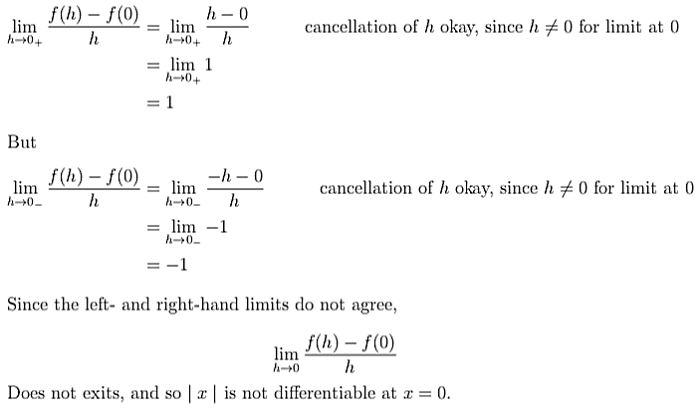
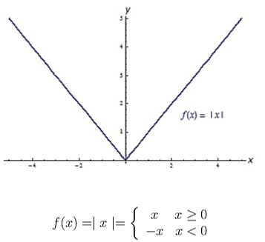
Differentiability

Slide 16
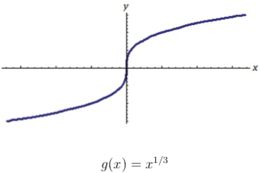
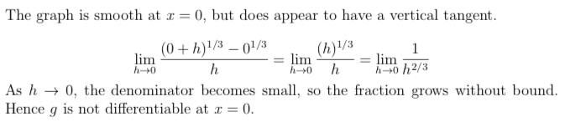
Differentiability

Slide 17


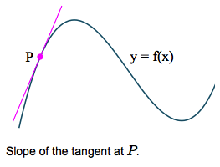
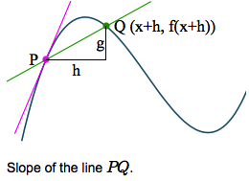
Differentiation from First Principle

Slide 18
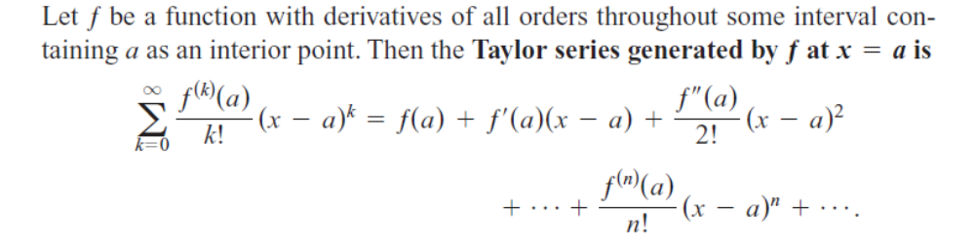
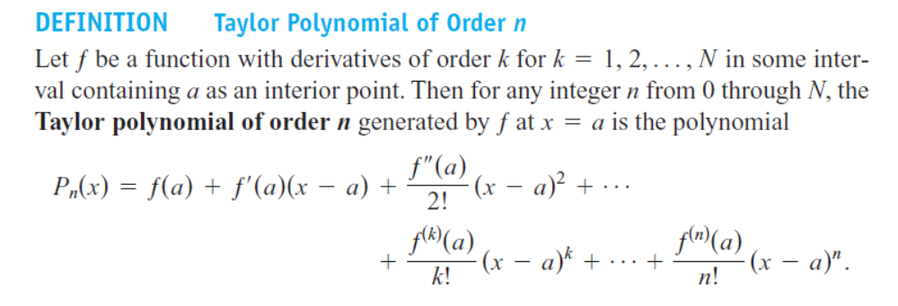
Taylor series

Slide 19
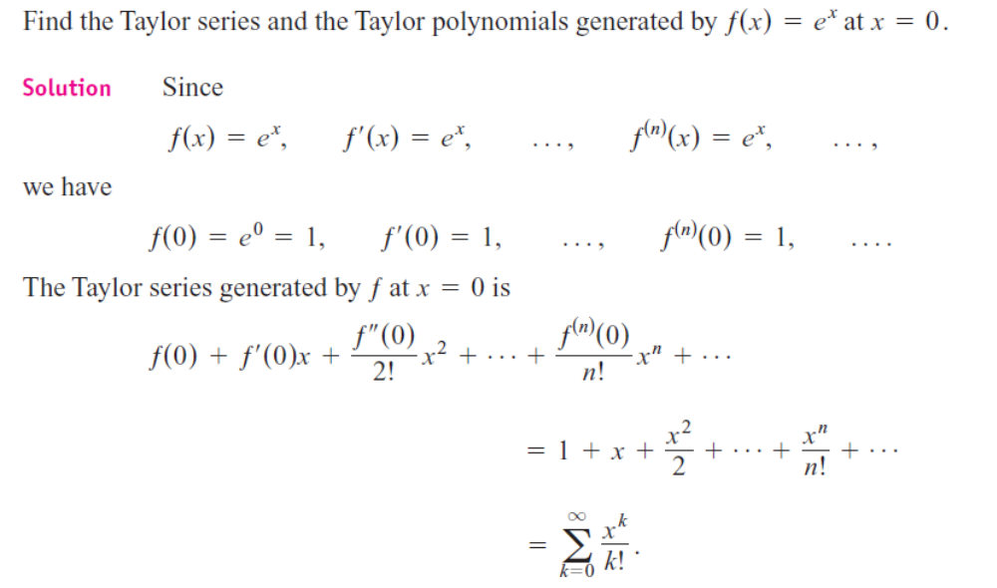
Example

Slide 20
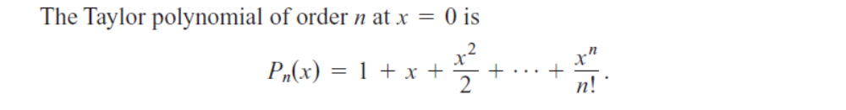
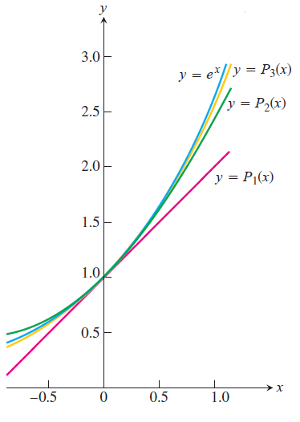
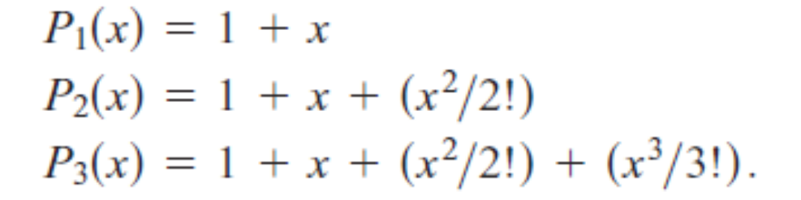
Example

Slide 21

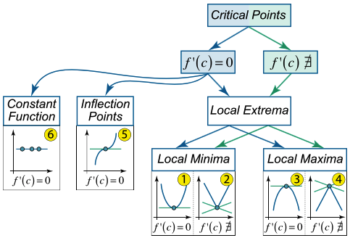
Critical Points

Slide 22
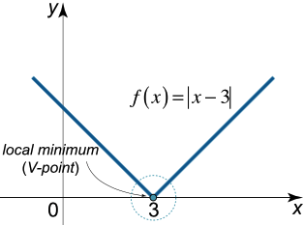
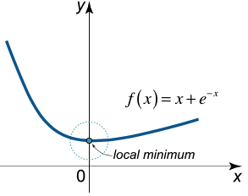
Critical Point - Local Minimum
x = c is local minimum if function changes from decreasing to increasing at that point
Derivative does not exist at this point

Slide 23
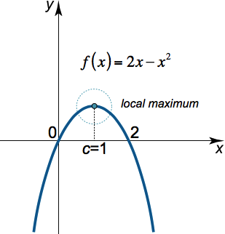
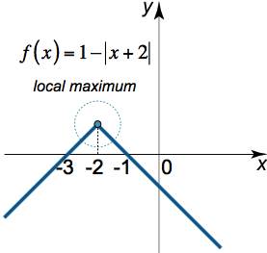
Critical Point – Local Maximum
Critical Point x = c is local maximum if the function changes from increasing to decreasing at that point
Derivative does not exist at this point

Slide 24
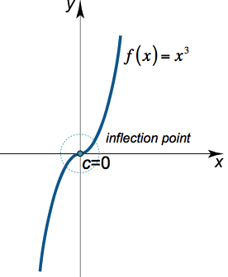
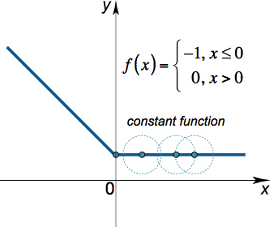
Critical Point
A critical point x = c is an inflection point if function changes concavity at that point
Each point of a constant function is critical

Slide 25
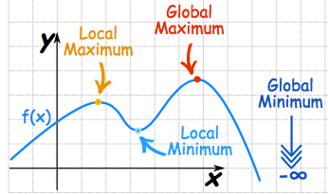
Global Maximum and Minimum
The maximum or minimum over the entire function is called Global maximum or minimum
There is only one global maximum and global minimum but there can be more than one local maximum or minimum

Slide 26
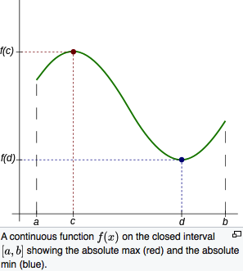
Extreme Value Theorem
Extreme Value Theorem guarantees that every function must have absolute(global) maximum and minimum
Assumptions:
f is continuous on an interval
Interval is a closed interval [a,b]
If either assumption fails, we are not allowed to draw conclusion that f hits minimum and maximum value on that closed interval

Slide 27

Second Derivative Test
First Derivative Test is used in conjunction with extreme value theorem to find the absolute maximum and minimum of a real valued function defined on a closed, bounded interval
After establishing the critical points of a function, second derivative test uses the value of second derivative at those points to determine whether such points are a local maximum or local minimum.
If a function f is twice differentiable at a critical point x (f ‘ (x) = 0 then

Slide 28
Second Derivative Test
Example : f(x) = 2x³ – 3x² – 36x + 2
f’ (x) = 0 ➔ 6x² – 6x – 36 = 0
x = 3 , -2
Compute f ‘’ (x) = 12x – 6
At x = 3 → f ‘’(3) = 12(3) – 6 = 30 > 0
At x = -2 → f ‘’(-2) = 12(-2) – 6 = -30 < 0
X = -2 Point is Maxima
X = 3 Point is Minima

